Slide 1
Large-scale extraction, structuring and matching of data
Deep Kayal
Machine Learning Engineer, Elsevier

Slide 2
How we managed to make sense of more than 100 million things!
Deep Kayal
Machine Learning Engineer, Elsevier

Slide 3
Quick Introduction
I work as a Machine Learning Engineer
At Elsevier
To use data (mostly text)
To make lives easier for people in healthcare and education (amongst others!)

Slide 4
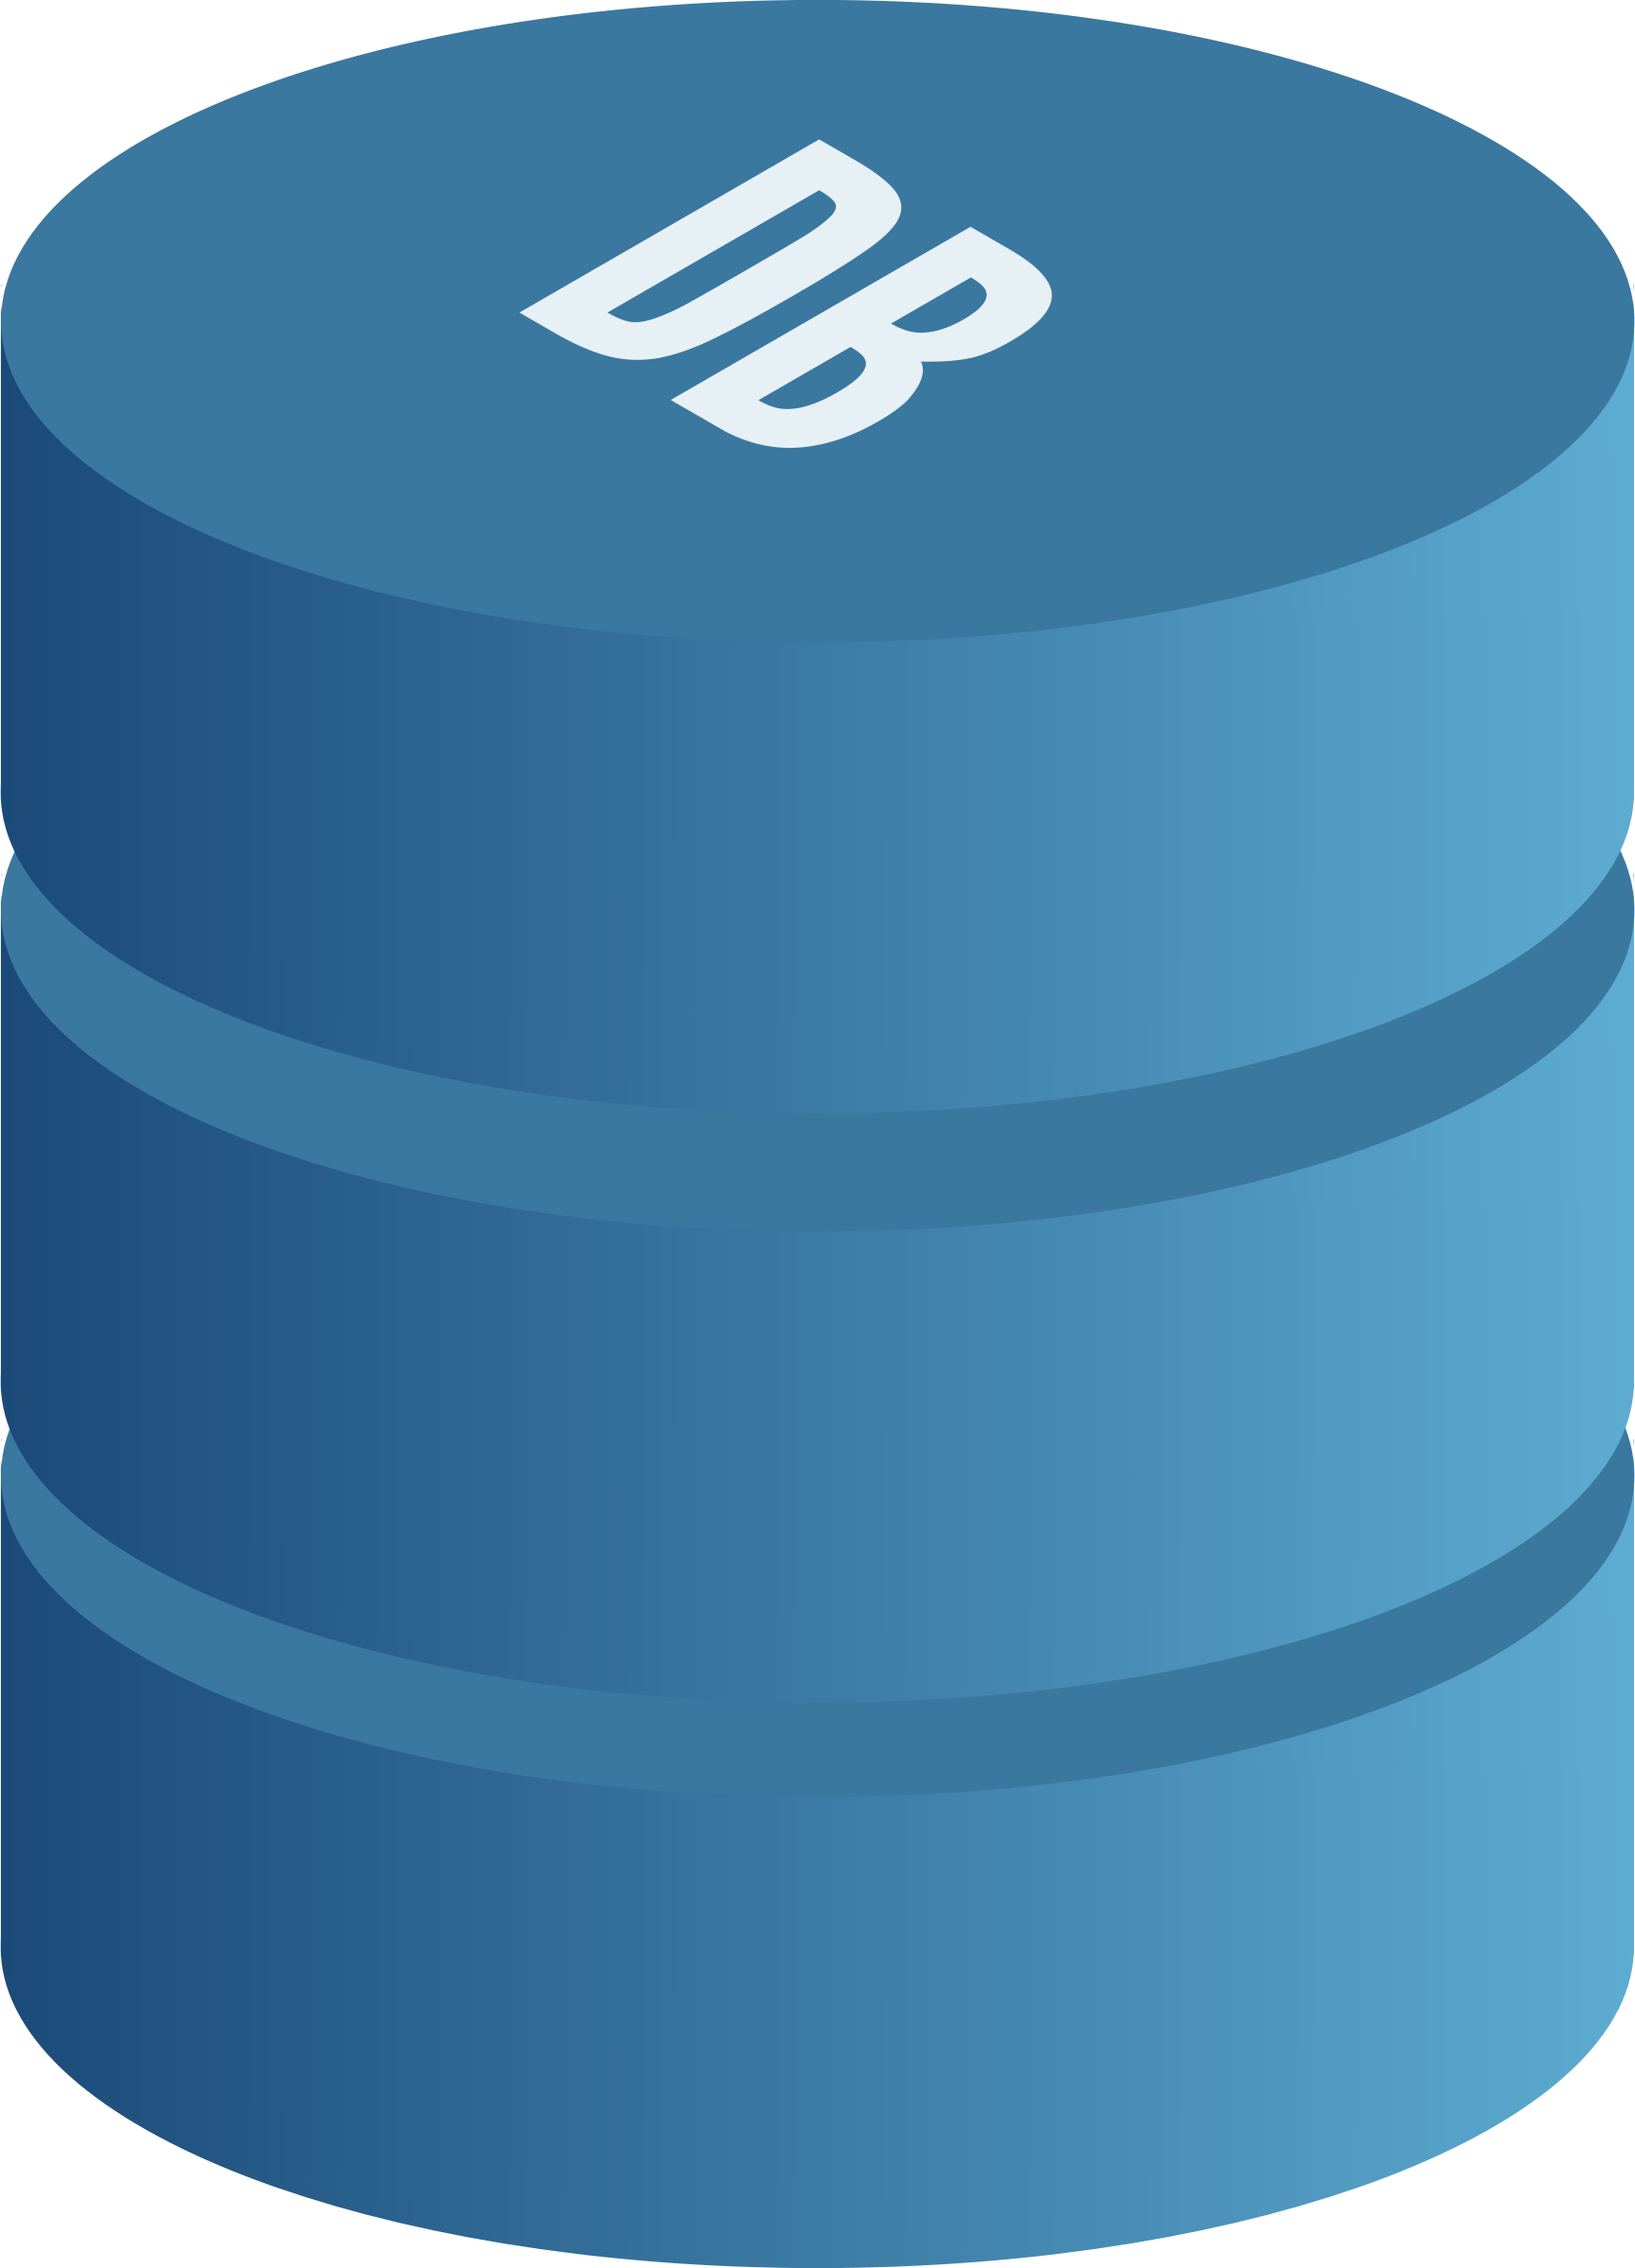
Setting the tone..
Good Data:
We know how it looks like
We could improve it’s quality
Data dump:
All over the place!
Could add information to the Good Data

Slide 5
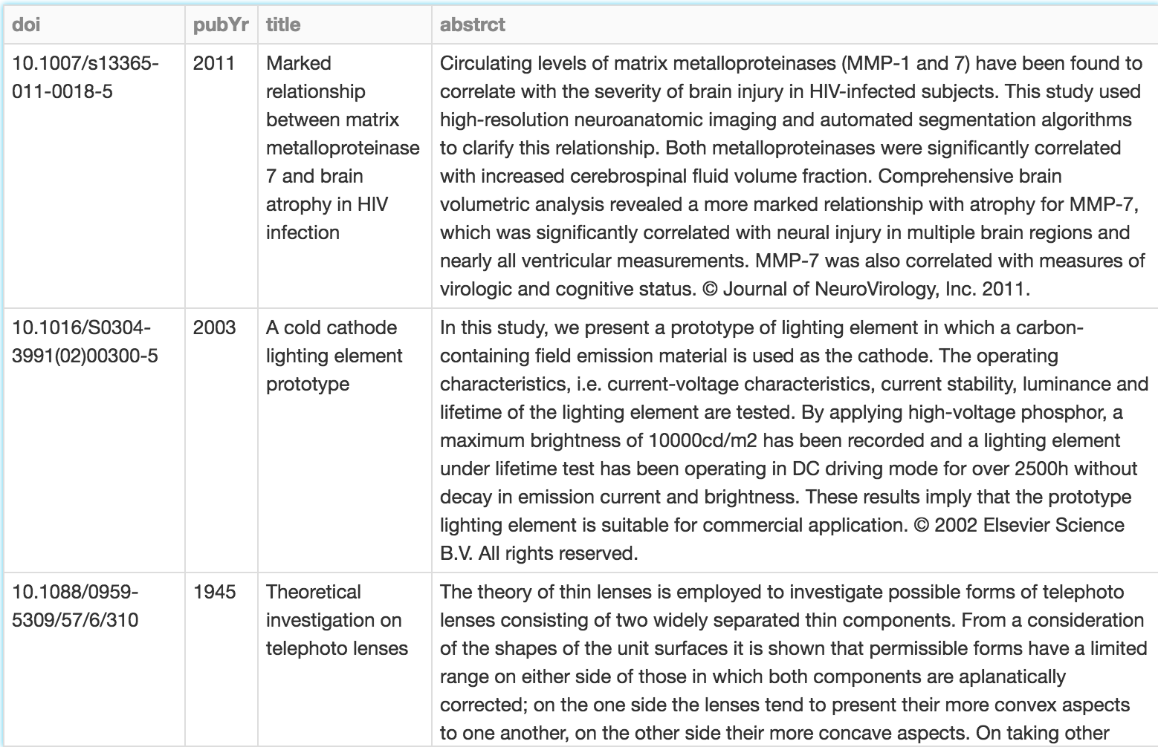
Specifically..
Good Data:
We know how it looks like
We could improve it’s quality

Slide 6
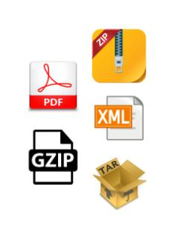
Specifically..
Data dump:
All over the place!
Could add information to the Good Data

Slide 7
What is so large-scale?
Good Data + Data Dump = Over 100 million files..

Slide 8
How do we do this?
The relevant questions are:
How to untangle the data mess?
How to extract useful information?
Using this information, how to it match to the Good Data?
Recurring: How to do this at scale?

Slide 9
Tech stack?
Win!

Slide 10
How to start untangling?
It is (probably) hard to generalizably automate the structuring of a data dump
But one can formulate some good enough assumptions about what’s in the dump(s)
By utilizing prior knowledge on how the data came to be
Or by sampling from the data
And use them to make an attempt at unarchiving

Slide 11
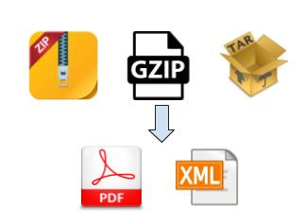
Our data dump
Simple or nested zips, gzips, tars

Slide 12
A very simple example of unzipping at scale
Distribute the files to Spark executors

Slide 13
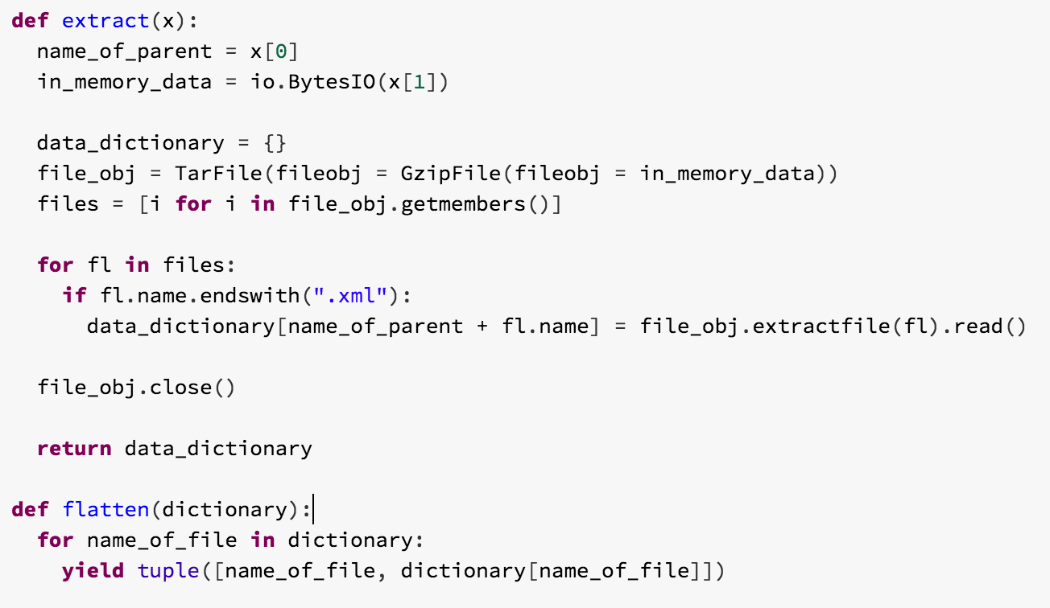
A very simple example of unzipping at scale..
Write some functions to unzip and flatten

Slide 14
A very simple example of unzipping at scale..
Use the functions via Spark to produce sequence files containing the unzipped file content

Slide 15
In the sequence file..

Slide 16
On to the next problem: extracting useful information
Like the last problem, this one needed us to make some well-formed assumptions too
Our task was to extract bibliographic information
Amongst the files we deemed relevant were
Mostly XML files
And PDFs
Extracting things from XML is relatively simple: using the xml library
Structuring PDFs is very hard: we tried using CERMINE (https://github.com/CeON/CERMINE) to do our best!

Slide 17
Let’s go through another example

Slide 18
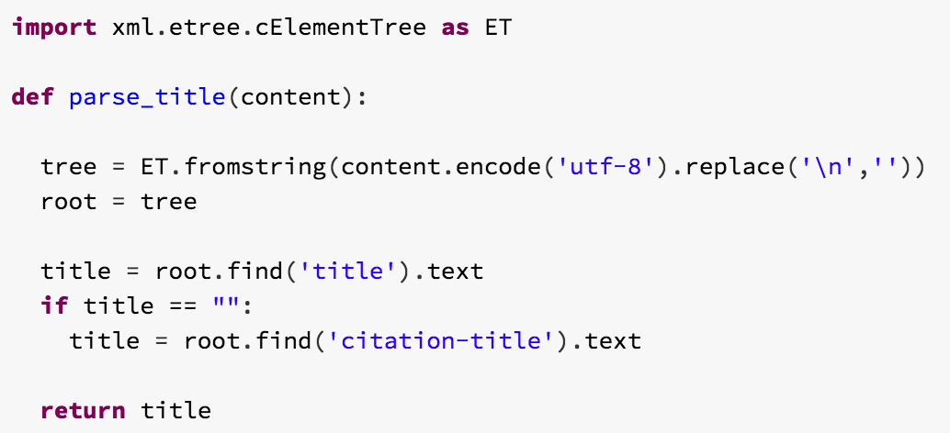
Let’s go through another example..

Slide 19
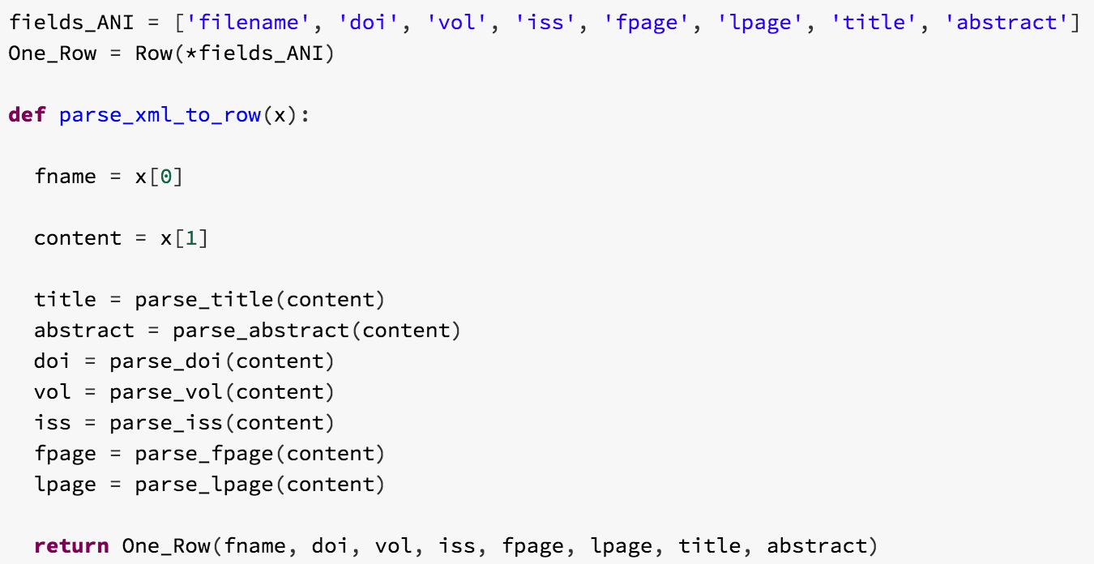
Scale up
Extract everything needed and make a Row out of it

Slide 20
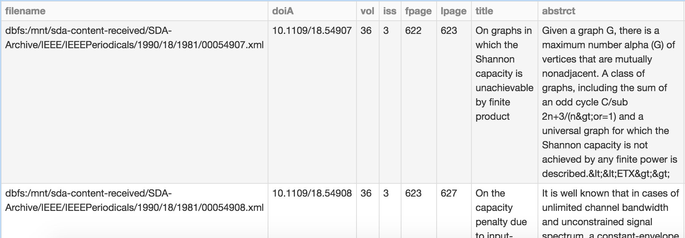
Scale up..
Make a table, and we’re ready to match!

Slide 21
Quick recap
Data dump:
All over the place!
Good Data:
We now know how it looks like

Slide 22
Matching?
How to match depends on what to match!
Matching can be exact or approximate
Joins are a great way to match exactly
But it needs some preprocessing:
This is a title vs This is a title.
Good preprocessing mechanisms are a great way to avoid approximate matching

Slide 23
Simple matching – Step 1: Normalize
Write a preprocessing function

Slide 24
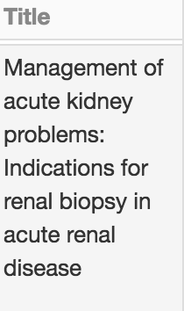
Simple matching – Step 1: Normalize..

Slide 25
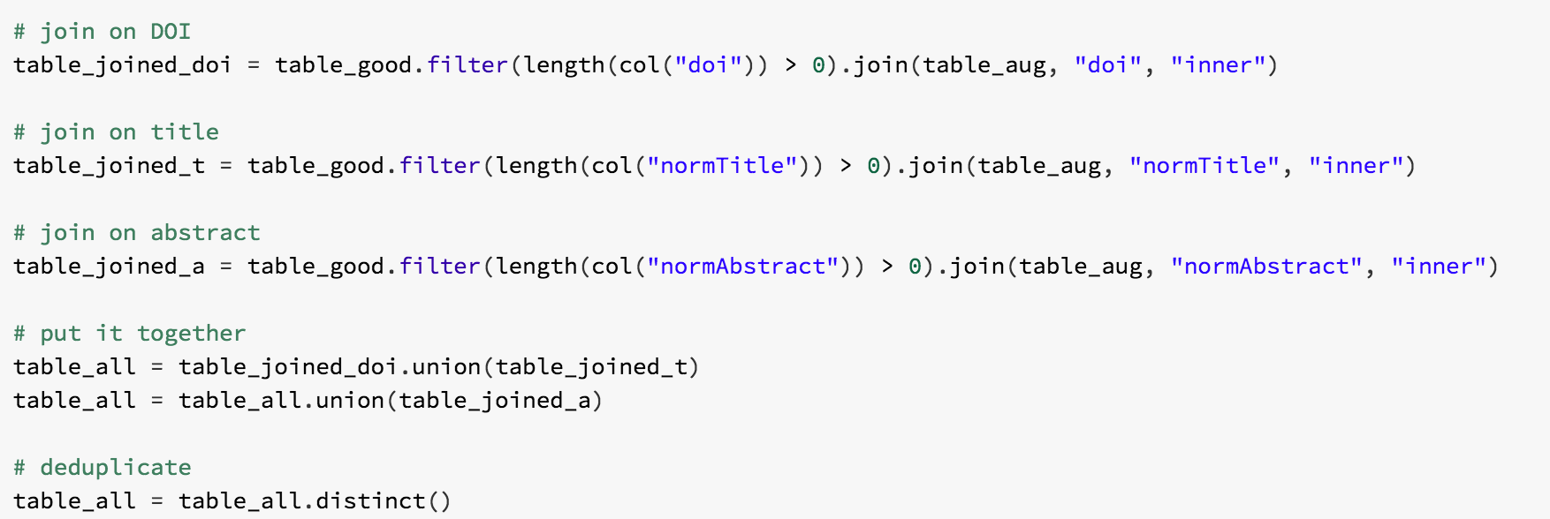
Simple matching – Step 2: Join and Union

Slide 26
Finally..
Matched pairs between one table (key: pui) and another table (key: filename)

Slide 27
In summary, from here..
Good Data:
We know how it looks like
We could improve it’s quality
Data dump:
All over the place!
Could add information to the Good Data

Slide 28
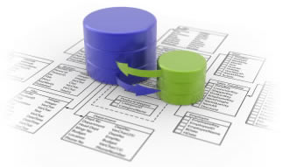
In summary, to here..
Match pairs by key
Match pairs ready to be processed for enrichment

Slide 29
Subproblems
How to untangle the data mess?
How to extract useful information?
Using this information, how to it match to the Good Data?
Recurring: How to do this at scale?

Slide 30
Thanks to..

Slide 31
Thank you!
Feel free to reach out to me at:
d.kayal@elsevier.com
And we’re always recruiting people like you:
https://4re.referrals.selectminds.com/elsevier
If you don’t find what you’re looking for there, email me directly and we can set something up!

