Slide 1
I Hate You, Computer ;)
How Machine Learning is Transforming Sentiment Analysis & NLP
Katharine Jarmul
Europython 2016
Notes:
Hello and welcome! Thank you so much to the organizers! To the volunteers! To the EuroPython SocialVerein!

Slide 2
Hello!
I am Katharine Jarmul
I love working with data in Python. Lots of data is text. :. I love working with text in Python…
You can find me at:
@kjam
http://kjamistan.com
Notes:
Programming Python since 2008
Working with data in Python since I started at newspapers, since then I’ve worked with large and small scale data analysis at a variety of large and small companies.
Co-author of O’Reillys book Data Wrangling with Python
Aimed at folks who want to learn Python
Twitter @kjam
Kjamistan.com (my company and website)

Slide 3
1.
I am not a Machine Learning Expert
I don’t have a PhD (in anything). I didn’t study astronomy or physics. I can’t derive equations on a board at will for you. I am *just* a Python developer.
Notes:
No really, I am not an expert.
I am a Python developer interested in applying machine learning concepts to my work and projects for fun and profit.
I have not worked at a research lab or written scientific papers on the topic.
If you are any of these things and wish to rebuke me / challenge my understanding / tell me I’m full of it, then please find me later or do so in the comment section. If you help me learn ML better, I will buy you a beer. :)
Please bear with me!

Slide 4
2.
Assumptions I’ve Made About You
You understand basics of Machine Learning. You have used nltk or other libraries to perform Natural Language Processing. You are interested in what’s new / how to do more.
Notes:
We won’t be covering the basics here of machine learning or NLP. This is classified as an advanced topic and there is limited time so we just won’t cover them here.
I will be doing a mixture of summarizing what’s new in the literature and non-Python worlds around Machine Learning and sentiment analysis
I will also be taking a look at what tools are readily available now for use and how to use them
I will finally be proposing some questions to you / data science folks / ML folks / NLP folks about the challenges we still face and what might be clear next steps

Slide 5
What We’ll Cover
Sentiment Analysis Fundamentals
Problems in Sentiment Analysis
Gensim, spaCy, TensorFlow, Theano
IBM’s Watson: Getting Emotional
New & Old Research
What’s Next?
Notes:
Not necessarily in order!

Slide 6
What We’ll Won’t Cover
The python library to download and determine sentiment automagically
Notes:
No magic bullet, sadly.
Most of the places or research getting great results are building and tagging their own lexicons or using highly trained models from other folks for the same purpose.
There are some links in this talk to great example and starter code, we don’t have time to review them but I recommend looking at them and testing them for your own sentiment analysis.
If you dont want to build your own and just use a package or service, there are those available (varying payment / open-source-ness) but just know thats not going to be anywhere near perfect. You are probably looking MAX at low 70s accuracy. MAX.
If I had to choose, metamind was amazing but according to a guy i met who works at salesforce, its never gonna be public or free or possibly not even available again :*(
If I had to do free: prob start with ensemble of some of the good easy ones: stanford tree + simple with a good lexicon….

Slide 7
3.
Sentiment Analysis 101
What is sentiment analysis? How do we go about it in Python?
Notes:
First, we’ll cover some of what sentiment analysis is and is NOT, we’ll talk a bit about the process and go through some of the steps you are likely to take when analyzing, building or working with a sentiment analysis system.

Slide 8
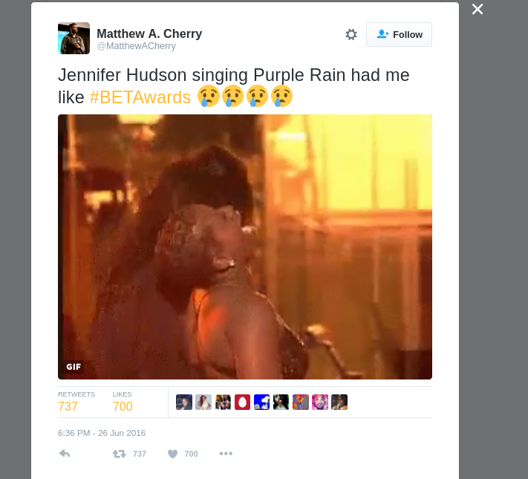
What is Sentiment Analysis RLLY?
Notes:
But what REALLY is sentiment analysis? We like to take these review datasets and box them into Positive, Negative and Neutral.
But Sentiment and Emotion are COMPLEX, just like us…
Is this tweet positive or negative? Towards who or what? Is it mixed?
Humans, even all native speakers, don’t always agree, so what does this mean for AI and automated solutions?

Slide 9
How is Sentiment Analysis Used?
Brand, Politics, Engagement Analysis
User Satisfaction
Recommendation Systems
Targeted / Retargeted Marketing
Anomaly Detection
QA & User Experience
Notes:
Recently went to a sentiment analysis symposium of all types, machine learning folks, IBM, marketing folks, translation software…sentiment is a hot topic for many different fields
Even heard of QA teams using them alongside charts for release dates to point to poor releases, or an analysis of different applications (i.e. how iOS reviews compare to Android vs web, etc)

Slide 10
Basic Sentiment Analysis Steps
Choosing or Building a Lexicon, Labeling
Choosing Algorithm,
Model Architecture
Sentiment Analysis
Process
Choosing Parser, Preprocessing Data,
Normalization / Standardization
Testing, Evaluation and Improvement
Notes:
Should you build your own Lexicon? Parser? Neural Net? Algorithm?
Your abilities to label data will somewhat depend on budget and time. Find balance between research academies and short-term thinking.
Preprocessing input / postprocessing results and normalizing or regularizing your results / input can help your algorithm, but make sure to analyze it before and after to ensure you are making it better. It also helps to have much more data or even add to your data (like cropping labelled images with CNN image recognition)

Slide 11
4.
Choosing or Creating A Lexicon
What do we need to have a good lexicon? Can we use lexicons from other fields?
Notes:
Having a NLP Corpora, Lexicon or even what type of mappings you use for your word embeddings are all decisions that clearly affect the outcome of your model / solution
We’ll talk about a few of the ways you can ensure you are asking the right questions, but there is MUCH more research and many more useful methods and examples if you want to spend time / effort / money on this part of your system

Slide 12
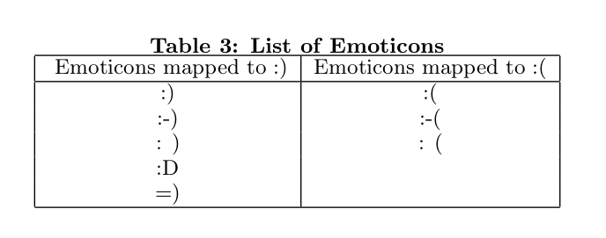
Autotagging a Lexicon
(Distance Supervision)
Go, Bhayani and Huang, 2009
Notes:
These can also be unicode characters or hashtags
You could even map memes to these via image recognition
Can also be used across different languages / to expand lexicon formulation for languages with smaller representation
Twitter140 from Stanford is trained in this way

Slide 13
Choosing Labels: What do you
want to show?
Positive, Negative (1, 0)
Positive, Negative, Neutral (1, -1, 0)
Positive, Negative, Neutral, Indeterminate
Positive → Negative (scale: -1, 1)
Positive → Negative (without normalized scale)
Categorizing by Emotion
Stance with Entity / Topic Detection
Notes:
Choosing your labeling method is just as important as your lexicon. Some of this likely depends on funds you have or resources you have for tagging.
Although a simple “on” and “off” switch work well for simple situations: I want to identify broadly negative vs positive tweets directed at our brand, it doesn’t allow for as much learning as introducing other elements, like a neutral or indeterminate (i.e. mixed) and it definitely can’t help with degrees of negativity and positivity or something as complex as stance.

Slide 14
Tagging a Lexicon
Best-Worst
Choose the most positive, most negative:
#boring, 😬, delicious, 👋
Sliding Scale
Rate this word / sentence / n-gram on a scale:
Completely Negative - Negative - Neutral - Positive - Completely Positive
Simple boolean
Negative / Positive (occasionally also Neutral)
Notes:
also sentiment annotation, esp for shorter texts like twitter or picking out a few words hashtags: The average Spearman rank correlation coefficient between S 1 and S 10 was 0.96, between S 2 and S 10 was 0.98, and S 3 and S 10 was 0.99. This shows that as few as two or three annotations per BWS question are sufficient to obtain reliable sentiment scores. (Capturing Reliable Fine-Grained Sentiment Associations by Crowdsourcing and Best–Worst Scaling)
It’s also been shown that esp when using same graders, they can tire, they avoid the edges and they show bias over time.

Slide 15
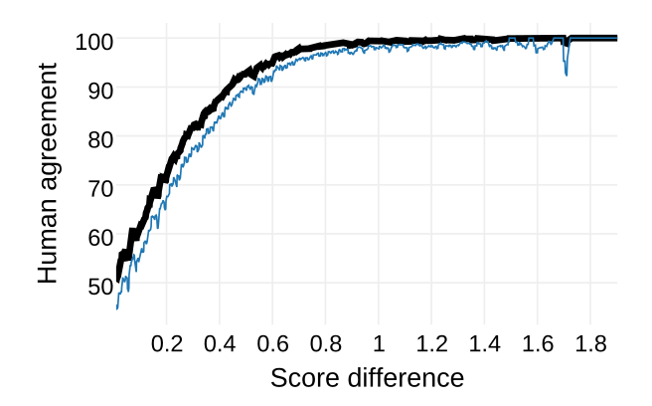
Finding Sentiment Agreement:
Least Perceptible Difference
Kiritchenko and Mohammad, 2016
Notes:
- also sentiment annotation, esp for shorter texts like twitter or picking out a few words hashtags: The average Spearman rank correlation coefficient between S 1 and S 10 was 0.96, between S 2 and S 10 was 0.98, and S 3 and S 10 was 0.99. This shows that as few as two or three annotations per BWS question are sufficient to obtain reliable sentiment scores. (Capturing Reliable Fine-Grained Sentiment Associations by Crowdsourcing and Best–Worst Scaling)
- even though we dont TOTALLY agree, we mainly agree: For sentiment scores between -1 and 1, we show that the perceptible difference is about 0.07 for English speakers. (The Effect of Negators, Modals, and Degree Adverbs on Sentiment Composition)

Slide 16
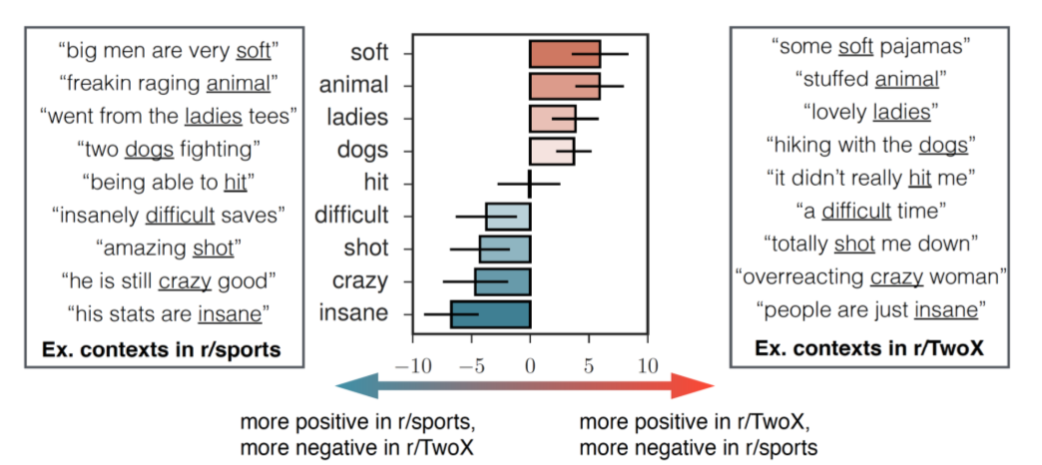
SocialSent: Learning New Sentiment and Lexicon via Unlabeled Corpora
Hamilton, Clark, Leskovec and Jurafsky, 2016
http://nlp.stanford.edu/projects/socialsent/
Notes:
William Hamilton and his coauthors were able to map the same words with differing sentiment depending on subreddits. This often exposed very different contexts for these words, and interestingly he found similar topics were covered in the same words with the same sentiment even in opposing subreddits (meaning this shared language is understood in communities whether they are for or aganst the topic)
The research also pointed out that these words change over time, especially long periods of time. This shows that language and sentiment evolve together and the time of your lexicon as well as the time of your incoming data should align for good analysis.
He has released the models, so if you are interested, take a look at them, use them, and chat with him!

Slide 17
SocialSent: r/programming
+
gold
minecraft
posix
200
nginx
hacks
spaghetti
messy
python: -0.12
Std Dev: 1.57
-
Hamilton, Clark, Leskovec and Jurafsky, 2016
http://nlp.stanford.edu/projects/socialsent/
Notes:
Took a look at r/programming and found some interesting tidbits
Also found out all of you are talking crap on python, so yah, you shouldnt do that. Go post nice things
I live with a gold nut so I wasn’t really that surprised gold was near the top HEHEHEH
You can imagine in a restaurant review, spaghetti hopefully has a positive connotation…. :)

Slide 18
5.
Choosing An Approach / Algorithm
How do we determine positive or negative? What machine learning systems can we use?
Notes:
The core of your system is your machine learning algorithm and your approach, this is no longer a simple question as now folks have implemented sentiment analysis with the help of deep learning (either via word embeddings) or even deep networks trained to recognize or identify sentiment.

Slide 19
Sentiment Analysis ML Approaches / Models
Bag of Words (BOW)
Term Frequency-Inverse Document Frequency (TF-IDF)
Word embedding aggregations / BOW
Doc2vec with tagging
MV-RNTN - Sentence trees
CNN / RNN with Word (or Doc) Embeddings
Semisupervised Learning
Finely Tuned “state-of-the-art” systems
Notes:
Sentiment analysis machine learning has evolved greatly in the past decade, and very swiftly in the past 4 years.
Started with bag of words approach, or the more evolved tf-idf (term frequency, inverse document frequency)
You can also use word2vec vectors / document aggregations with tags to train either simple models like naive bayes or Linear SVM or you can use them for more complex deep learning models
Within those vectors you can also utilize skip grams or choose bigrams, trigrams unigrams to focus your model’s learning
Stanford has worked on sentence trees and recursive neural tensor networks, which are not very speed efficient but have been shown to have great mappings of complex grammar.
Semisupervised learning has been shown to grow deeper feature recognition and might hold significant weight in natural language processing (like what’s happening in analyzing LSTM for sentiment)
There are also several for-pay state of the art systems with great scores, such as Twitter140

Slide 20
Sentiment Analysis Approaches
Oldies | Newbies
Bag of Words | Word Embeddings
TF-IDF | Doc2vec
unigrams | skip-grams / dependencies
supervised | semisupervised
Notes:
Made a chart. Even if something is in the oldies side here, it doesnt mean it’s actually out of use, it just means its an older approach.
Term frequency inverse document frequency
There are plenty of old and good things in the world.
However the newbies column is where a lot more new research focus and use cases are being defined.

Slide 21
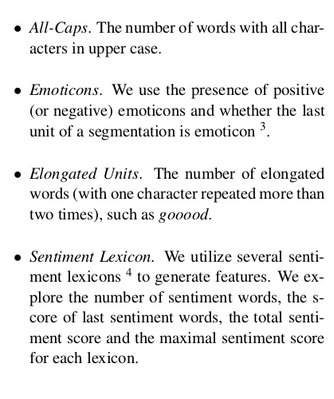
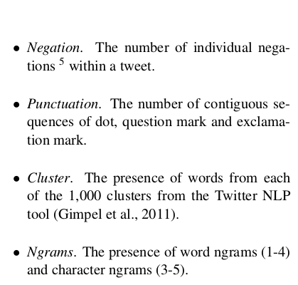
State of the Art Sentiment Features
Tang, Wei, Qin, Liu and Zhou, 2014
(orig. Mohammad et al., 2013)
Notes:
Sentiment features for an incredibly powerful state of the art system built by Said M. Mohammad and team at National Research Council of Canada (NRC Emotion Lexicon) and many SemEval compititions.

Slide 22
Gensim and Word2Vec / Doc2Vec
What is Word2vec? Doc2vec?
Skip-Gram or Continuous Bag of Words?
Word Embeddings: A mathematical basis for natural language processing (moving beyond the counts)
Gensim library: Helping Python Developers with Word Embeddings since 2010
Glove-python available for GloVe implementation
Notes:
Word embeddings, document embeddings: LDA2vec (latent direlect association) → how can we create a mathematical representation of words / documents?
Proven to show relationships between words
Gensim is the lead right now in the space, having python based implementations for both word2vec and doc2vec
You can use skip-grams or negative sampling as well as continuous bag of words
There are also other methods not yet implemented in the library

Slide 23
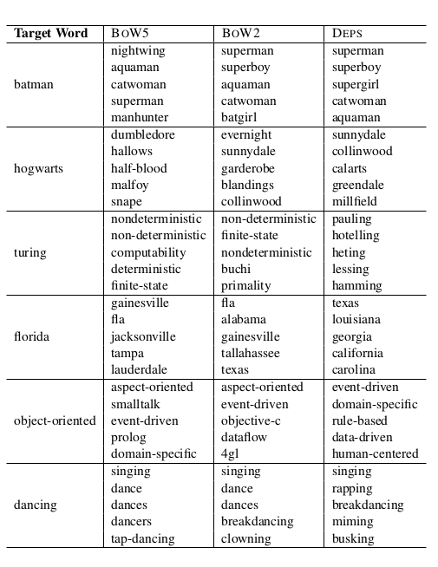
Word
Embeddings:
Different
Methods,
Different
Results
Levy & Goldberg, 2014
Notes:
Depending on how you determine your word embeddings, you will get different results.
You can use a skip gram or bag of words approach, or negative sampling, or even a dependecy based approach like what levy and goldberg published here.
Your method is NOT ambivalent!

Slide 24
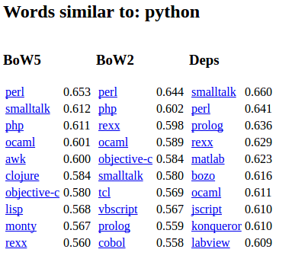
Online Comparison:
Word Embedding Methods
http://irsrv2.cs.biu.ac.il:9998/?word=python
Notes:
If you want to compare some word models in the space you are interested, I recommend taking a look at the interactive online. It also has some more information available with the dependency lines.

Slide 25
Word Embeddings... Not Neutral!!
King - Man + Woman = Queen
Doctor - Man + Woman = Gynecologist / Nurse
Professor - Man + Woman = Asst. Professor
Professor - Woman + Man = Professor Emeritus
Try searching most similar for: Mexicans, immigrants, Negroes (yes, it exists), Asian and Jews with topn=30
(Bolukbasi, Chang, Zou, Saligrama and Kalai, 2016)
Notes:
Recent paper on sexism and racism in word2vec Google News
Depending on your text and time windows, this can essentially become a bot like Tay
How do we handle ethics? How do we handle bias, prejudice, racism, sexism in our machine learning, especially around language? Especially around SENTIMENT and emotion?

Slide 26
Gensim with Labels: Word2Vec
Great examples:
http://linanqiu.github.io/2015/10/07/word2vec-sentiment/
https://districtdatalabs.silvrback.com/modern-methods-for-sentiment-analysis
Notes:
If you want to do a simple machine learning approach (or a shallow one) you basically want to pass in tagged vectors like so. Those links have good examples for using this with a Logistic regression or linear SVM approach.

Slide 27
Gensim with Labels: Doc2Vec
Labeled Sentences
Great examples:
http://linanqiu.github.io/2015/10/07/word2vec-sentiment/
https://districtdatalabs.silvrback.com/modern-methods-for-sentiment-analysis
Notes:
If you are looking at doc2vec, you would utilize the labeled sentences which are built into Gensim (you can also model your own), but essentially you have a vector representing the list of words and then you have a LABEL, here I have an integer but often folks use a string as well such as POS NEG NEUTRAL

Slide 28
Choosing n-gram length (RNTN)
Socher, Perelygin, Wu, Chuang, Manning, Ng and Potts, 2012
Notes:
The stanford tree (Matrix-vector - RNTN) shows a clear relationship between long n-grams and mixed sentiment.
As you can see from the histogram, these longer phrases and sentences show a much wider variety of emotion
If you’re dealing with long text, or documents, this is an important note… You can use a model like this to capture, or you need to find a way to break down overall sentiment in sentence parts or via using a good parser

Slide 29
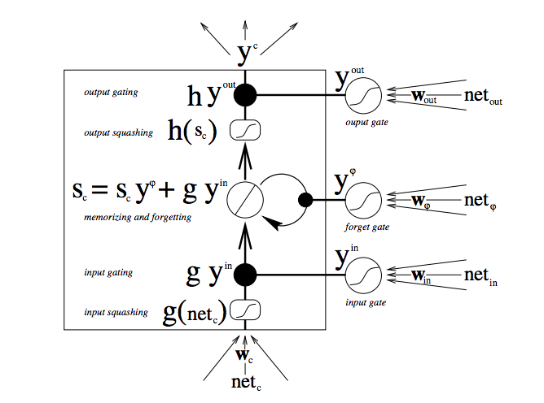
LSTM with Theano / TensorFlow
DeepLearning4J
Notes:
Long Short Term Memory deep learning example as shown on deeplearning4j
This type of recurrent neural network which utilizes an algoritm to remember / forget.
Has been shown to be better at language and NLP problems than some other algorithms: when you think about it it makes sense. If I see something everyday I need to know that word. If I memorize just what’s cool today then in about 2 years I will be old/uncool AF.

Slide 30
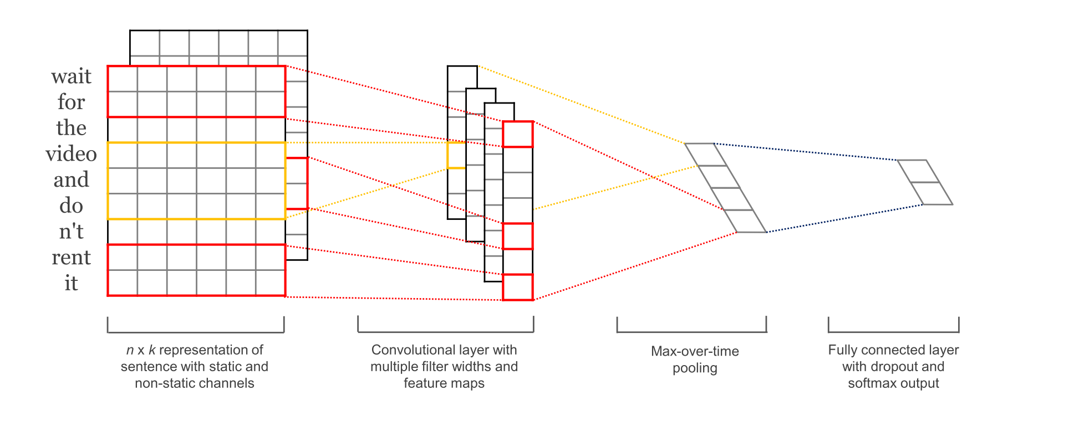
CNN: Moving from Images to Text
http://www.wildml.com/2015/12/implementing-a-cnn-for-text-classification-in-tensorflow/
Notes:
Convolutional neural networks have been pretty popular in Image recognition: word embeddings and doc embeddings are allowing it to move into text.
Attaching vectors to show sentiment helps these succeed, although they are not yet as popular as recurrant neural networks or LSTM in the space

Slide 31
Deep Learning: Labeled Text
Great examples:
http://deeplearning.net/tutorial/lstm.html
https://github.com/jpmcd/TensorflowSentiment
https://github.com/dennybritz/cnn-text-classification-tf
Notes:
Check out these links for some examples with both Theano and Tensorflow.
They have varying levels of success, but the idea is again, to create vectors for your documents or n-grams and then have labels, here for example we use a simple array to represent positive emotion (going up) versus negative emotion (going down)

Slide 32
Semisupervised processes with Distance Supervision
Lexicon /
Autotagging / Input
Simple
Classifier
Deep Learning System (RNN, CNN, ANN)
Notes:
Semisupervised has big gains in natural language processing, probably because of the massive amount of text available for free online
If you can create a shallow or simple classifier with a good accuracy, you can use that as a data source for your deep learning epochs
Then you have a system similar to the above, where the deep learning system can evolve over time being fed by either new lexicon you are able to tag or by the simple classifier

Slide 33
6.
Regularization, Preprocessing and Parsing
To tag or not to tag? To preprocess or not to preprocess?
Notes:
Depending on your algorithm, you may have varied results for your preprocessing or you may choose a model that requires you to do so.

Slide 34
Preprocessing is essential (or is it?)
Lemmatization
Removing “stop” words, rare words
Removing duplicate punctuation/letters, or creating symbols to represent groups (cooll rather than every variation of coollllll, etc)
Spellcheck
Caution: try not preprocessing or minimal as baseline, your processing *may* harm your sentiment model
Notes:
Depending on what algorithms you choose and what your dataset looks like or how it is collected, you’ll likely need to implement some preprocessing
This can mean looking at spelling errors, removing stop words, lemmatizing or stemming your words as well as removing special characters (i.e. emoji)
However, some studies show overcorrecting by preprocessing actually hurts the final results, and like we saw in the STATE system, sometimes these differences can show a sentiment difference. I.e. when I put ;) i can be showing playfulness or even negation

Slide 35
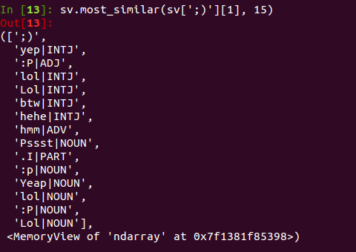
Sense2Vec and spaCy
Google_ORG vs. Google_VERB
Large Reddit Corpus
Notes:
POS tagged word embedding
Trained on both formal and informal text
Ability to see ;) as a possible interjection, affiliation with humor (lol) and playfulness and possibly antagonism, negation, or questioning (hmm / Yeap / btw / hehe)
Can also use GLOVE vectors from Stanford

Slide 36
6.
IBM Watson: Getting Emotional
Can emotional tagging show us more ranges of sentiment?
Notes:
IBM has been working on stance, tone and personality analysis, can we use emotions to help us determine what we are REALLY saying?

Slide 37
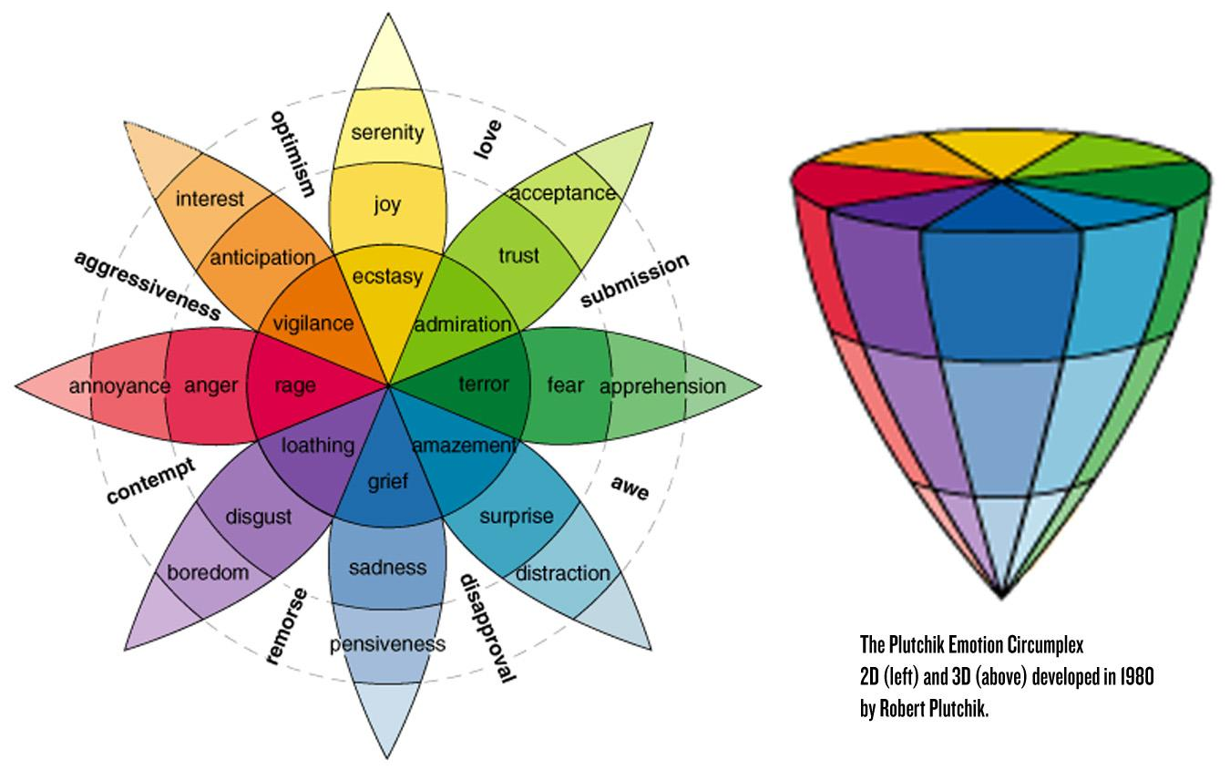
Varied Emotions,
Varied Sentiment
Notes:
How do these relate to sentiment?
If I say a “positive” thing expressing disgust, is it actually positive or negative? To whom? Do we need to incorporate stance in most sentiment analysis?

Slide 38
IBM Watson: Analyzing Emotion & Tone
https://tone-analyzer-demo.mybluemix.net/
Uses AI to categorize:
Anger
Joy
Fear
Distrust
Sadness
Social Tendencies and Language Style analysis also offered
Notes:
- watson personality mixed with lda2vec or word2vec to determine actual word meanings? (positive and social: YAYYY versus pessimistic YAYYYY)

Slide 39
6.
What’s Unsolved? Undetermined?
What does the latest research say? What hasn’t been touched upon?
Notes:
Language is evolving, so is social media. Thankfully, so are our systems, but will we ever “catch up” and does the solution depend largely on what we’re trying to say and about / to whom?
Existential sentiment questions ;)

Slide 40
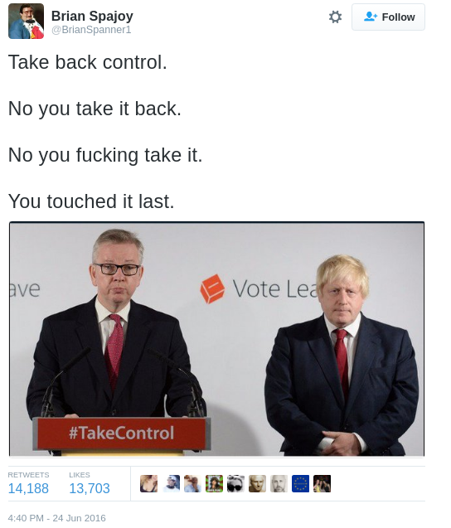
Humo(u)r
Notes:
Wit? Is it lost on machines?

Slide 41
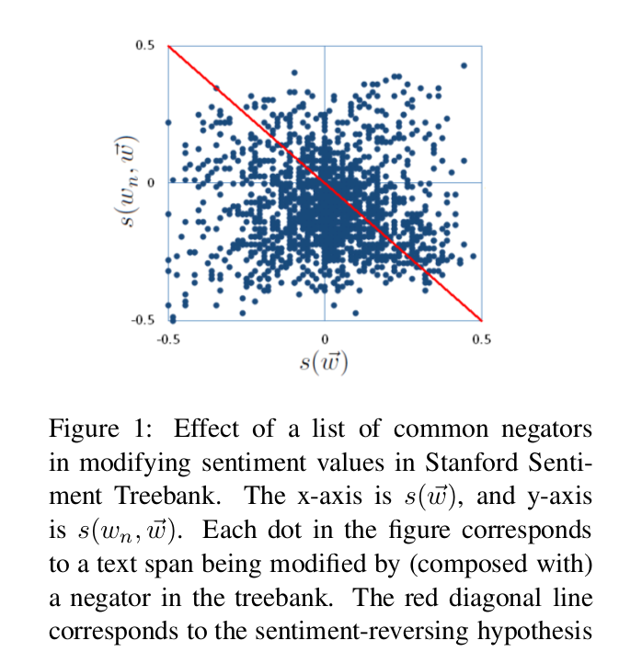
Negation (uni/bigram)
Zhu, Guo, Mohammad and Kiritchenko, 2014
Notes:
One prominent myth is that sentiment can be shown as simply a negation of the other word. But when we think about it, does not bad actually mean good? Does not terrific mean the opposite of terrific? Does not boring mean exciting?
As shown in this study, and several others, negation (of unigrams, bigrams) does not show an inverse relationship when charted along a range of sentiment

Slide 42
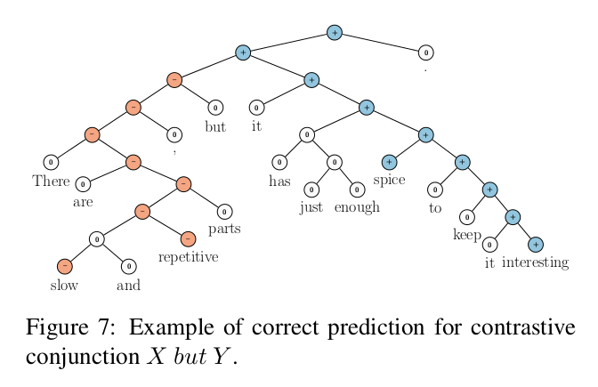
Stanford Sentiment Trees: Negation
Socher, Perelygin, Wu, Chuang, Manning, Ng and Potts, 2012
Notes:
The recurrent neural tensor network learns negation rules from parsing tree structures. Also called matrix vectorization recursive neural network
Much of this is dependent on a good tagged corpora to learn… How do I know which branch of the tree is more positive or negative? (these are of course all learned by the model, but even humans disagree on these results, especially the longer the document)
[Word2vec pipeline] Vectorize a corpus of words
[NLP pipeline] Tokenize sentences
[NLP pipeline] Tag tokens as parts of speech
[NLP pipeline] Parse sentences into their constituent subphrases
[NLP pipeline] Binarize the tree
[NLP pipeline + Word2Vec pipeline] Combine word vectors with neural net.
[NLP pipeline + Word2Vec pipeline] Do task (e.g. classify the sentence’s sentiment)

Slide 43
What’s (Still) Hard?
Negation
Sarcasm & Irony
Mixed Sentiment
Complex Emotions
Colloquialism, Slang, New / Old Phrases
Speaker Intention / Personality
General NLP Issues:
Misspellings, Acronyms, Hashtags, Lolspeak, Choosing Context, Never-Before Seen
Notes:
what to do about words its never seen, human intervention? user intervention?
Sarcasm and Irony are still very much unsolved and areas of active research. I’ll touch a bit more on that later.
If you are interested in mixed sentiment, you can take a look at the stanford trees as a good base, or read up on stance work, where researchers are working on entity detection and then generally using proximity or other NLP parsing to determine which sentiment words apply to which entities
When I say #prayforistanbul am I happy or sad?
When something is cool af… I mean really really cool, right? How do we keep up with these new phrases?

Slide 44
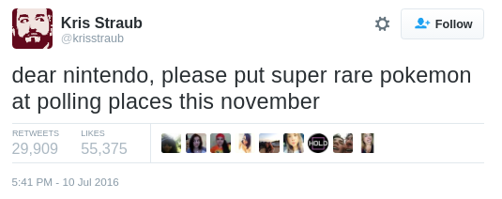
Cultural References
Notes:
How can we tell a machine about pop culture?

Slide 45
Speaking via Images
and GIFs
Notes:
Can we incorporate image and video analysis with text analysis to really understand the new world of social media?
Snapchat sentiment?
Gifs are generally well tagged...

Slide 46
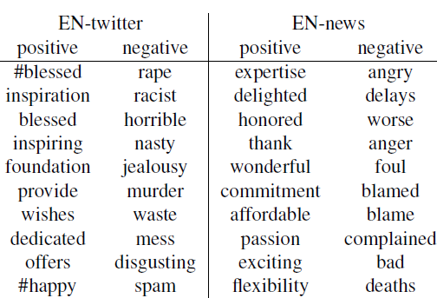
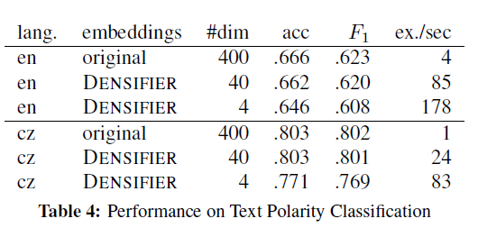
Densify: Are Dense Word Embeddings A Solution for Speed?
Rothe, Ebert and Schütze, 2016
Notes:
Similar results in terms of speed using ANNOY with word2vec (Approximate Nearest Neighbors Oh Yeah) to find nearest neighbors in vector space
First element of the vectors represents sentiment.
Trained on German and English, trained models are available for use
Faster computation, no large drop in performance

Slide 47
Mo’ Solutions, Mo’ Problems
Deep Learning at Scale and Speed
Integration of different social media into input streams
Different Lexicon? Corpora? Embeddings?
Advanced Word Embeddings / Lexicon:
Aggregation Points: By Buyer Location, By Demographic
Irony and Mixed Sentiment Detection
Ensemble Methods
Character-level Embeddings
Notes:
- chris moody excellent chat re: lda2vec in real business sense
---- does comparing geographies help us create lda models for semantic analysis
---- does comparing time windows help (i.e. one customer corpus from 2 years ago is not them today, etc)
---- does comparing one clients voice to a vector return better analysis (can we start answering the question: what does this person mean when they say YAY its raining given different personality traits / types / a personal corpus?)
---- alongside human loop: is this relevant? did it lead to a sale? did the stylist like it? was it useful?

Slide 48
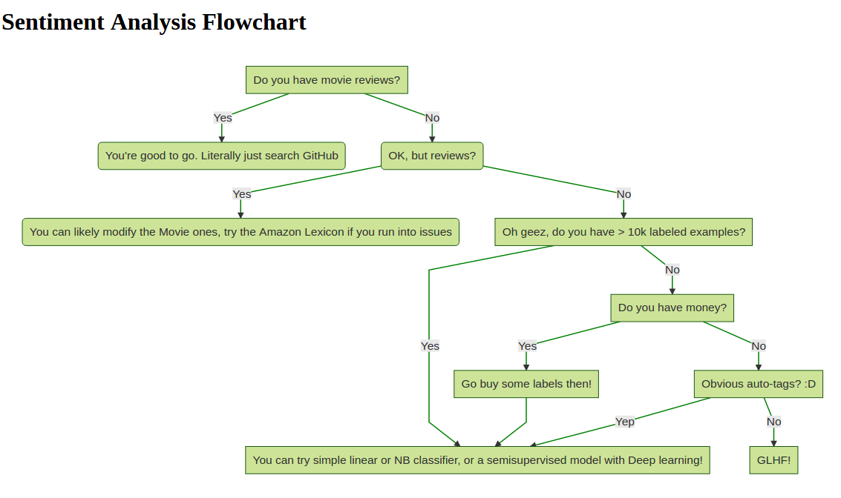
Notes:
Made as a joke inspired by Andreas Müller’s Skikit learn flowchart

Slide 49
TL;DR: Have we “solved” Sentiment Analysis?
Short answer: Not completely.
Longer answer: It depends on what you are trying to do, how you define sentiment analysis and how much data you have (both in your Lexicon and your active data for testing). Deep Learning may unlock some of the nuances and stumbling blocks!
Notes:
The solution, like many with machine learning, lies in the ability to spend time building a good model, good dataset, and determining how to help improve your system through observation, testing, debugging and more research

Slide 50
Thanks!
Any questions?
Reach out!
@kjam
katharine@kjamistan.com
Presentation template by SlidesCarnival
Notes:
I normally talk about simple data / data pipelines, and I have some O’reilly courses and a book
When winter comes I plan on blogging more, so feel free to follow along on my website
I regularly schedule classes at conferences as well as via my company, so if you’d like to hear more, follow me on Twitter or reach out via email.

